Slide 1
Selenium Webdriver - Python
Installation of Python
Presented by: ENGR.SUMREENA BANO

Slide 2
Step wise Python installation
Download the latest Python Windows installer by going to http://www.python.org/ftp/python/ and selecting the highest version number listed, then downloading the .exe installer.
Double−click the installer, Python−2.xxx.yyy.exe. The name will depend on the version of Python available when you read this.
Step through the installer program.
If disk space is tight, you can deselect the HTMLHelp file, the utility scripts (Tools/), and/or the test suite(Lib/test/).
If you do not have administrative rights on your machine, you can select Advanced Options, then choose
Non−Admin Install. This just affects where Registry entries and Start menu shortcuts are created.
After the installation is complete, close the installer and select Start−>Programs−>Python x.x−>IDLE (Python GUI). You'll see something like the following:
Python 2.3.2 (#49, Oct 2 2003, 20:02:00) [MSC v.1200 32 bit (Intel)] on win32
Type "copyright", "credits" or "license()" for more information.
****************************************************************
Personal firewall software may warn about the connection IDLE
makes to its subprocess using this computer's internal loopback
interface. This connection is not visible on any external
interface and no data is sent to or received from the Internet.
****************************************************************
IDLE 1.0
>>>

Slide 3
Selenium Web-driver Installation
Download and install geckodriver1.8 (from https://github.com/mozilla/geckodriver/releases ) on path as follows;
“C:\Users\mariyam\AppData\Local\Programs\Python\Python36-32”
Open up the command line shell (cmd) for windows.
Navigate to the path where python is been installed on your PC, in my case its “C:\Users\mariyam\AppData\Local\Programs\Python\Python36-32\Scripts”
Once navigate to the directory, write the following command
C:\Python35\Scripts\pip.exe install selenium
Please refer next slide, this should gets displayed on your command line for successful installation of selenium

Slide 4
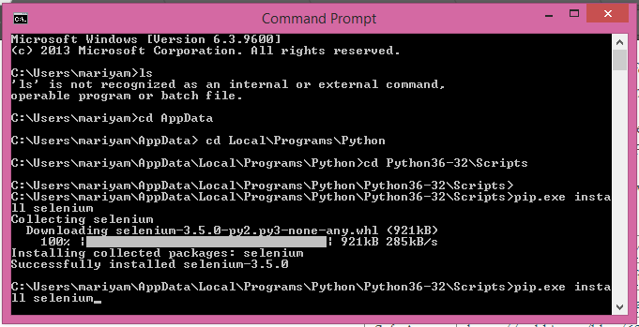
Selenium Web-driver installation (Cont..)

Slide 5
Installation of eclipse
Get the software from shared ip i.e. 192.168.0.251
Install eclipse with JDK and JRE, if required
Install Pydev using following link
http://www.rose-hulman.edu/Class/csse/resources/Eclipse/eclipse-python-configuration.htm

Slide 6
References
https://github.com/mozilla/geckodriver/releases
# https://docs.djangoproject.com/en/1.11/howto/windows/
https://www.jetbrains.com/pycharm/download/#section=windows

